Slide 1
Can Modulators of Inflammation Serve as Biomarkers for Subclinical Atherosclerosis in Rheumatoid Arthritis?
Kimberly P. Liang, Douglas P. Landsittel, Suresh R. Mulukutla, Steven E. Reis, Marc C. Levesque, Donald M. Jones, Rachel Gartland, Ali Hakim Shoushtari, Flordeliza S. Villanueva, Hunter C. Champion, Larry W. Moreland
Research Day
May 22, 2014

Slide 2
Disclosures
Research support:
  National Institute of Arthritis and Musculoskeletal and Skin Diseases (NIAMS) of the National Institutes of Health (NIH) under Award Number 5K23AR061407-02
  Made possible by Grant Number 2UL1 RR024153-06 from the National Center for Research Resources (NCRR), a component of the NIH, and NIH Roadmap for Medical Research (support for CTSI)
  Made possible by Genentech, NIH / NIAMS Award Number 1RC2-AR-058989 (support for RACER study); the Margaret J Miller endowed chair for Arthritis Research (Dr. Moreland); and institutional funds from the University of Pittsburgh Division of Rheumatology and Clinical Immunology and the Department of Medicine
  The content is solely the responsibility of the authors and does not necessarily represent the official views of the NCRR or NIH, Genentech, or the University of Pittsburgh.

Slide 3
Background
Rheumatoid arthritis (RA) is independently associated with an approx. 2-fold higher risk of cardiovascular disease (CVD) and premature atherosclerosis
Mechanisms of atherosclerosis include:
  Endothelial dysfunction/activation mediated by intercellular adhesion molecules (e.g., ICAM-1, VCAM-1, E-selectin) and oxidative stress (e.g., through MPO activity)
  Inflammation mediated by cytokines (e.g., IL-6)
  Plaque stability mediated by CD40-CD40L interactions
  Proteolysis/Plaque rupture mediated by proteolytic enzymes (e.g. MMP-9)

Slide 4
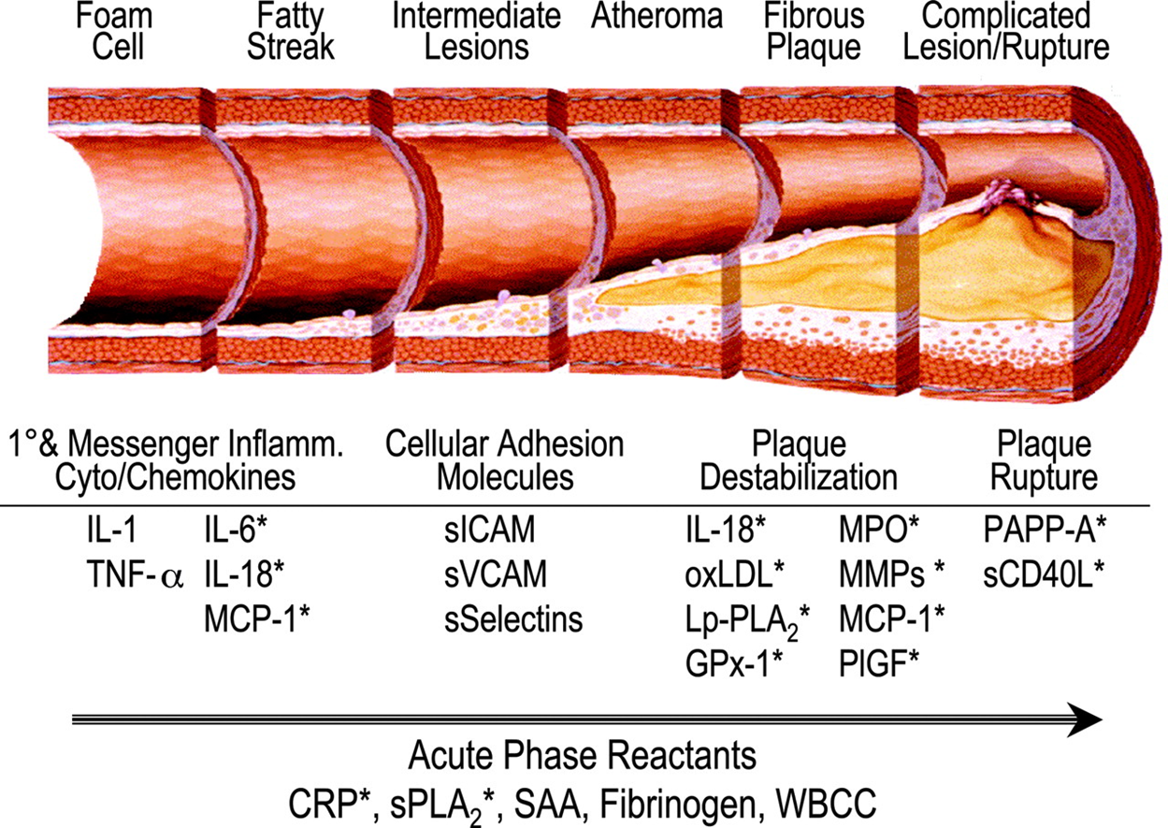
Biomarkers of Inflammatory Modulators and Atherosclerosis
Koenig W, and Khuseyinova N, Arterioscler Thromb Vasc Biol. 2007;27:15-26.

Slide 5
Objective
To evaluate whether these serum immune and inflammatory biomarkers are:
  higher in RA subjects, and/or
  associated with subclinical carotid atherosclerosis

Slide 6
Methods
46 RA cases (participating in RACER study)
70 controls (non-RA or other autoimmune disease)
Carotid ultrasounds were performed with measurements:
  Intima-media thickness (cIMT, using max of both sides)
  Plaque presence (of either side)
Serum biomarkers were measured by ELISA in all subjects:
  ICAM-1, VCAM-1, E-selectin (adhesion molecules)
  Myeloperoxidase (MPO)
  Interleukin-6 (IL-6)
  CD40L
  Matrix metalloproteinase-9 (MMP-9)
Data on demographics and CV risk factors were collected in all subjects
Disease activity (CDAI) and duration were collected in all RA subjects

Slide 7
Methods, cont.
Each of the biomarkers, cIMT, plaque presence, and demographic data, were tested for differences between cases and controls, using:
  Wilcoxon rank-sum test (for continuous data) or
  Chi-square test (for categorical data)
The relationship between each serum biomarker and cIMT or plaque presence was tested by Spearman correlations or rank-sum test (for IL-6 only).
  IL-6 was categorized as above detection limit or not; only 21% of subjects had detectable IL-6 levels.

Slide 8
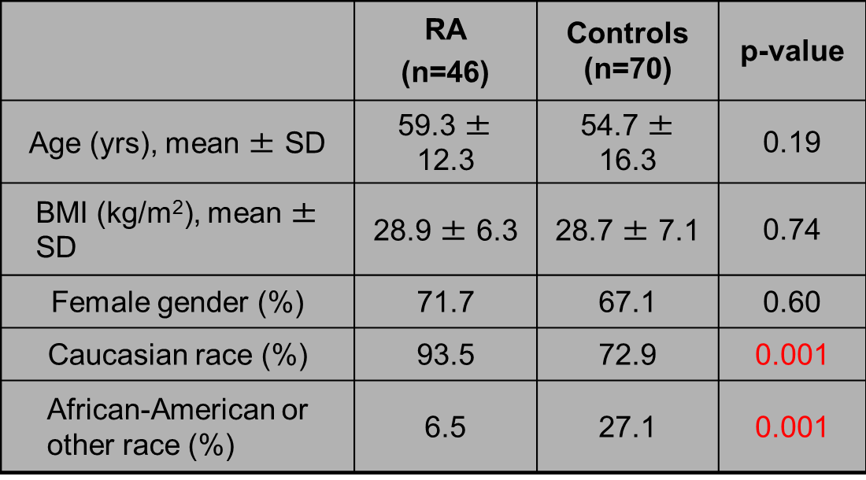
Results: Subject Characteristics
Mean age, BMI, and gender frequency were similar between RA and controls.
Race was significantly different (more African-American controls).

Slide 9
Results: Subject Characteristics, cont.
Characteristics of RA subjects (n=44):
  Mean (+/- SD) CDAI was 8.55 (+/- 8.05)
    Median CDAI was 6.75 (IQR 2.75-14.75)
    CDAI of 2.9-10.0 = low disease activity
  Mean (+/- SD) disease duration was 13.06 (+/- 9.58) years
    Median disease duration was 9.39 (IQR 5.47-17.89) years

Slide 10

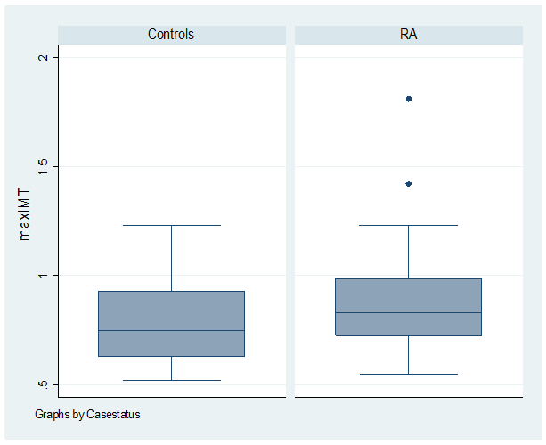
Results: cIMT in RA vs. Controls
Mean cIMT was higher in RA (0.88 ± 0.23 mm) than controls (0.79 ± 0.19 mm); p=0.02.

Slide 11

Results: Biomarkers in RA vs. Controls
Table 2. Plaque and Serum Biomarkers of Atherosclerosis in RA and Controls
 | RA (n=46) | Controls (n=70) | p-value
Plaque presence (%) | 47.8 | 37.7 | 0.28
ICAM-1 (ng/mL) | 260.4 ± 78.7 | 239.4 ± 79.8 | 0.18
VCAM-1 (ng/mL) | 881.4 ± 238.5 | 902.2 ± 312.0 | 0.75
E-selectin (ng/mL) | 34.0 ± 11.0 | 34.2 ± 13.2 | 0.83
MPO (ng/mL) | 594.9 ± 670.9 | 727.4 ± 464.6 | 0.011
IL-6 (pg/mL) above detection limit (%) | 31.8 | 14.3 | 0.025
CD40L (pg/mL) | 9034.2 ± 4762.6 | 9086.7 ± 2890.6 | 0.25
MMP-9 (ng/mL) | 446.7 ± 318.3 | 480.8 ± 213.4 | 0.085

Slide 12
Results: Biomarkers in RA vs. Controls, cont.
Figure 2. MPO in RA vs. Controls
Mean (+/-SD) MPO was lower in RA (594.9 +/- 670.9)
than controls (727.4 +/- 464.6) (p=0.01).

Slide 13
Results: Biomarker Correlations with cIMT
Figure 3. Correlations of ICAM-1, VCAM-1, and E-selectin with cIMT
ICAM-1: r = 0.361, p<0.001
VCAM-1: r= 0.283, p=0.002
eSelectin: r = 0.318, p<0.001
ICAM-1, VCAM-1, and E-selectin were positively associated with cIMT in overall group.

Slide 14
Results: Biomarker Correlations with cIMT, cont.
Mean cIMT was higher in those with IL-6 above detection limit (0.91 vs. 0.80; p=0.05).
Though not significant, detectable IL-6 was higher in those with plaque (28.3%) than in those without plaque (14.9%); p=0.08.

Slide 15
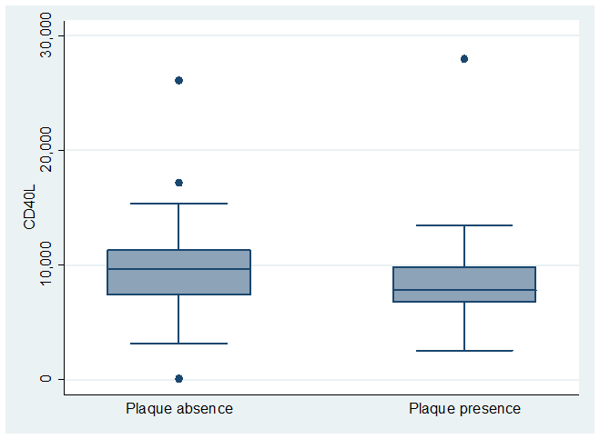
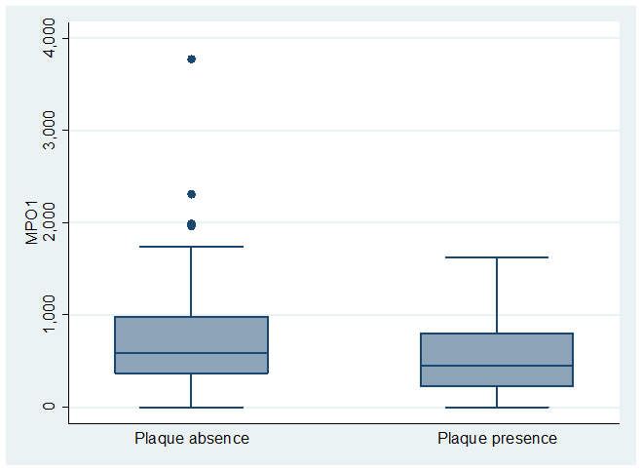
Results: Biomarker Relationship to Plaque
Figure 4. Box Plots of CD40L and MPO by Plaque Presence
Wilcoxon rank-sum test, p=0.0235
Wilcoxon rank-sum test, p=0.0462
Mean (+/-SD) CD40L and MPO were lower in those with plaque presence
(8385 +/- 3803 for CD40L and 554 +/- 454 for MPO) compared to plaque absence (9433 +/- 3535 for CD40L and 754 +/- 605 for MPO).

Slide 16
Results: Correlations in RA and Controls Separately
Results were similar when examined in the RA and control groups separately
  Magnitude of correlations with cIMT was slightly higher in the control group for ICAM-1 and E-selectin (r=0.4).
In the RA group only, mean ICAM-1 was higher (292) in those with plaque than in those without plaque (234) (p=0.045).

Slide 17
Discussion
Our findings confirm other studies showing a higher mean cIMT in RA
Immune complexes that fix C1q may be a source of arterial injury initiating atherogenesis
  Bind to C1q receptors on the endothelium → upregulation of adhesion molecules (E-selectin, ICAM-1 and VCAM-1)¹
Previous studies have shown VCAM-1 associated with increased cIMT and plaque in RA²
Our study showed correlations of all 3 adhesion molecules with cIMT in the overall group
¹Lozada C, Levin RI, Huie M, et al. Proc Natl Acad Sci U S A 1995;92:8378-82
²Dessein PH, Joffe BI, Singh S. Arthritis Res Ther 2005;7:R634-43

Slide 18
Discussion, cont.
IL-6 was positively correlated with cIMT and had a trend for correlation in those with vs. without plaque
  Systemic inflammation key in RA and atherosclerosis
Unexpectedly, we showed an inverse correlation of CD40L and MPO with cIMT and plaque presence
  Associated with high-risk CVD lesions in general population.
  May be due to limitation of our small sample size and wide variability in these biomarkers’ levels
  Alternatively, may indicate differential effects of these biomarker pathways in subclinical atherosclerosis in RA
  Future larger studies needed

Slide 19
Conclusions
cIMT is higher in RA than non-RA subjects
Markers of endothelial dysfunction (ICAM-1, VCAM-1, E-selectin) are significantly associated with higher cIMT
Possible common pathways of atherosclerotic progression as evidenced by cIMT and biomarker elevation
Further studies are needed to determine the predictive ability of biomarkers in CVD risk stratification algorithms in RA patients

Slide 20
Thank You!
Questions?

